Slide 1


Accounts Payable Operations and Reporting in Oracle ERP
Supplier Invoices, Payment Processing, and Period-End Closing

Slide 2

About Us:
Team Leader:
Nada Ahmed Ibrahim Seddik (1121325332)
Team Members:
Mohamed Khallaf Mourad Mohamed (21020711)
Al`aa Fawzi Abdelgawad (21009361)
Hamdy Atta Esmael Hashem (21049661)
Ahd Abdelkader Mohamed (222163306)
Ebrahim Elsayed Mohmoud (21020337)

Slide 3

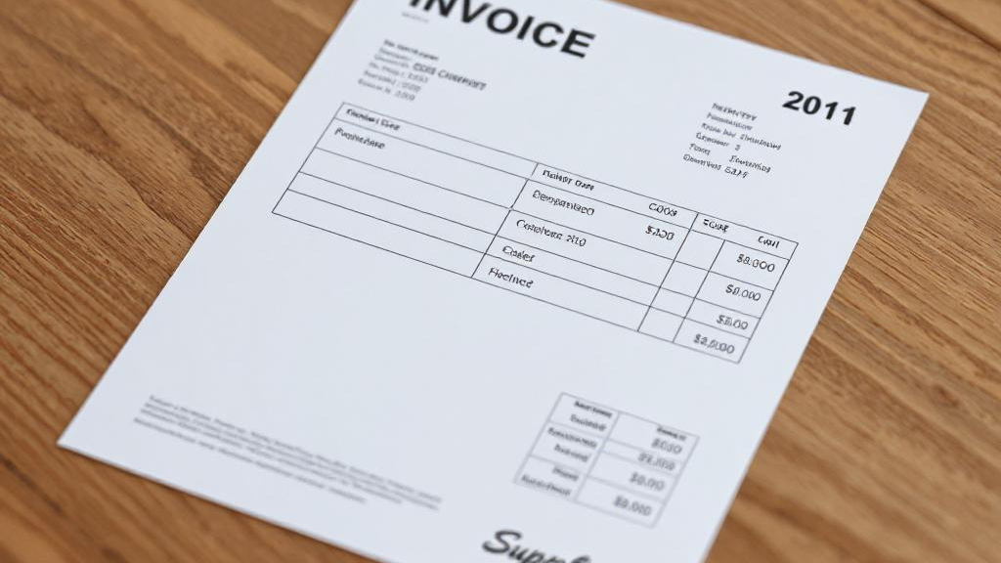
Supplier Invoices

Slide 4


Payables, Vision Operation (USA)
create supplier:
navigator: supplier - entry

Slide 5
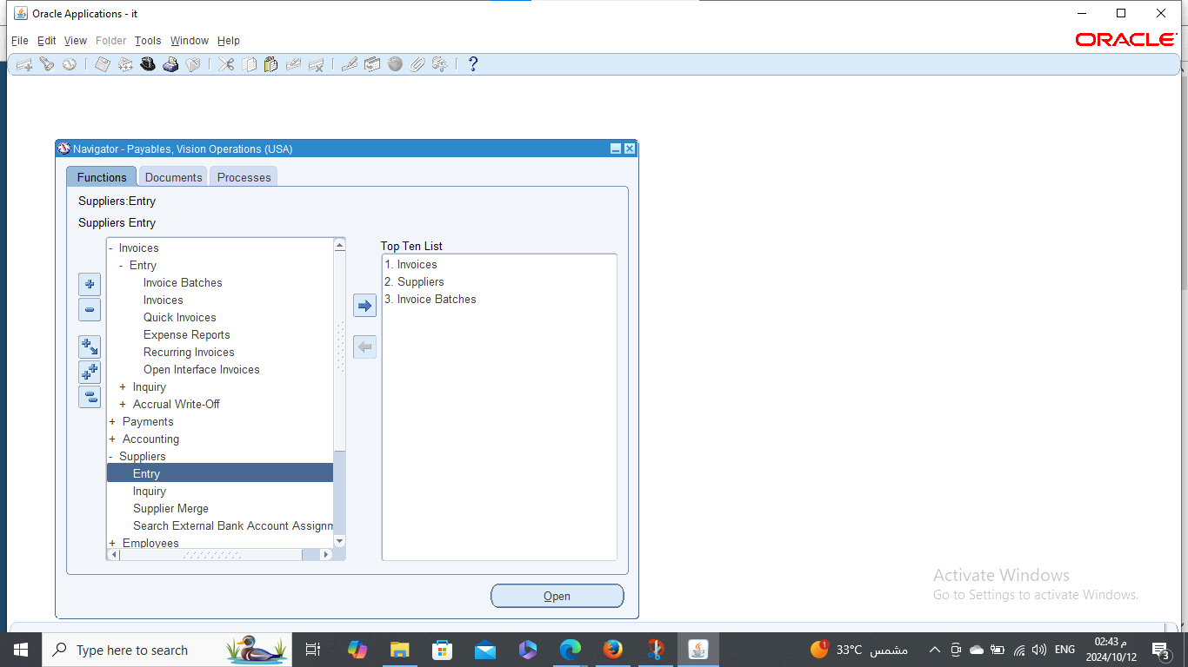

Slide 6
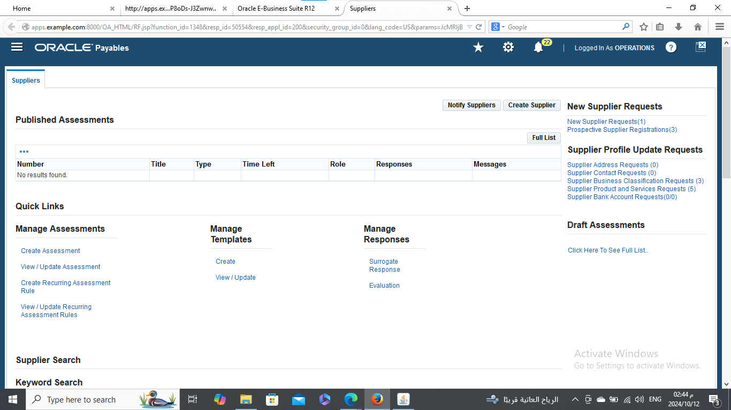
Select create supplier

Slide 7
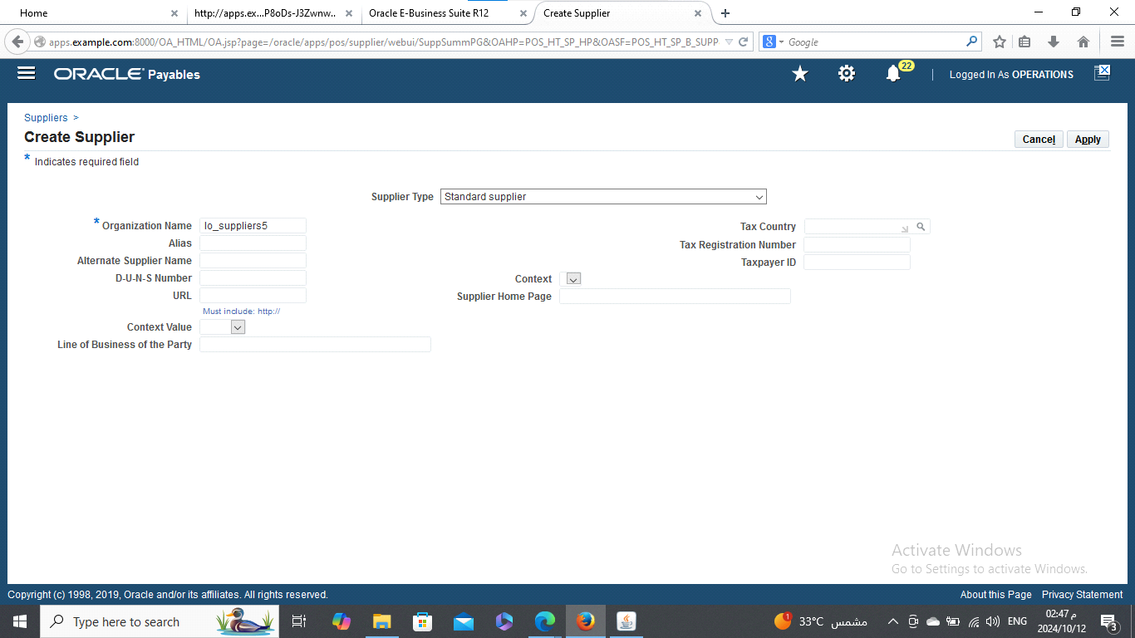
Enter the organization name then apply

Slide 8
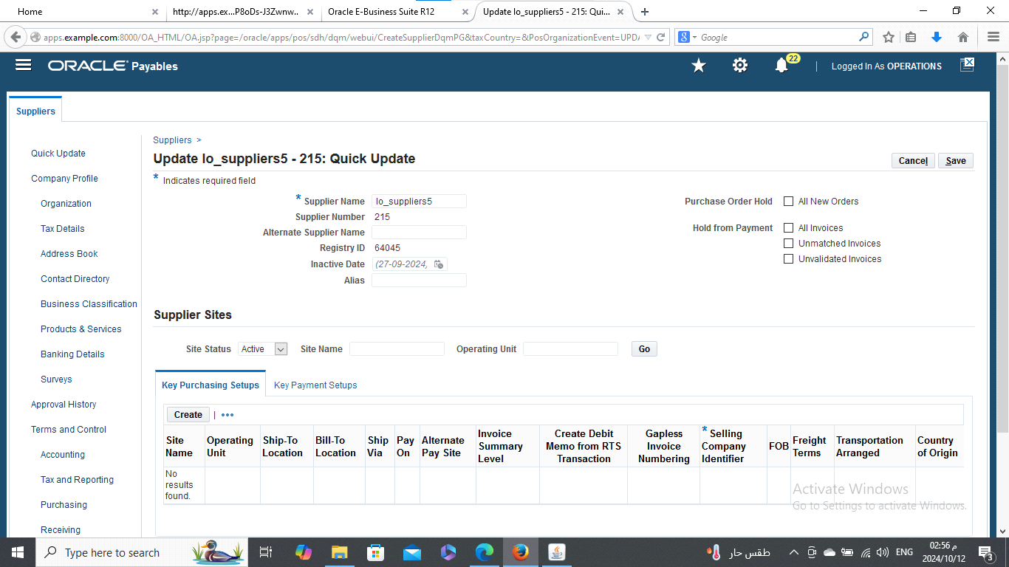
Select create new organization

Slide 9
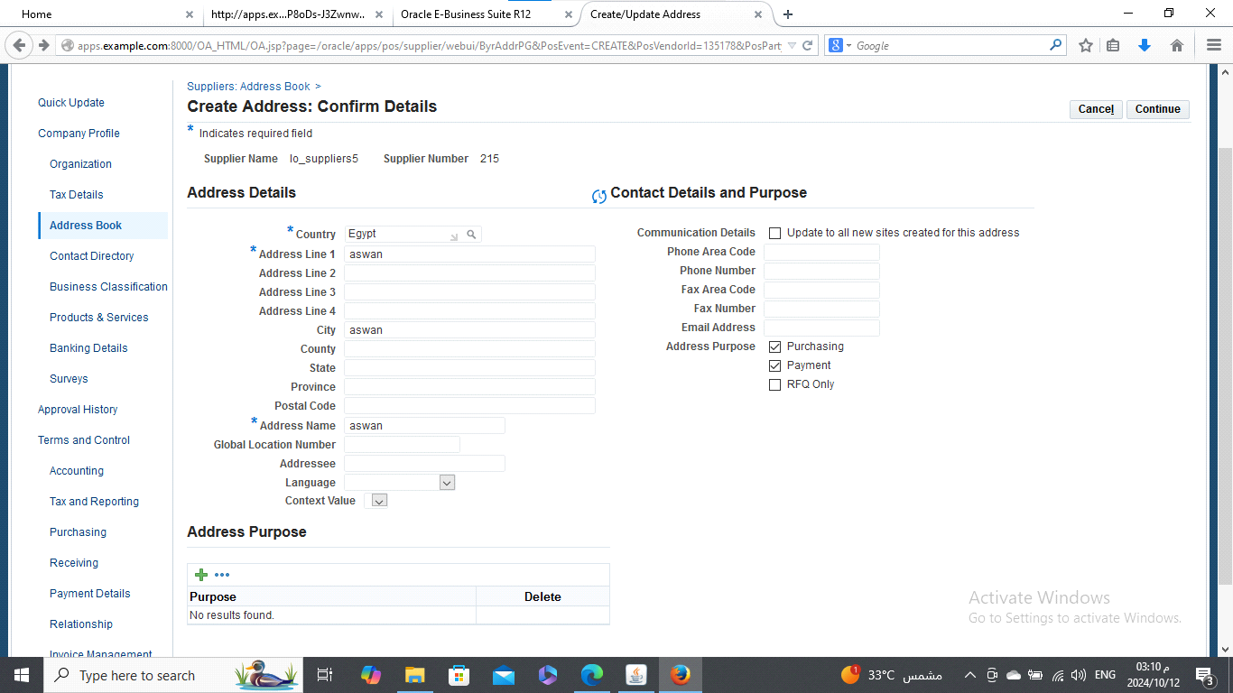
Entre the address details and select the purchasing and payment then continue

Slide 10
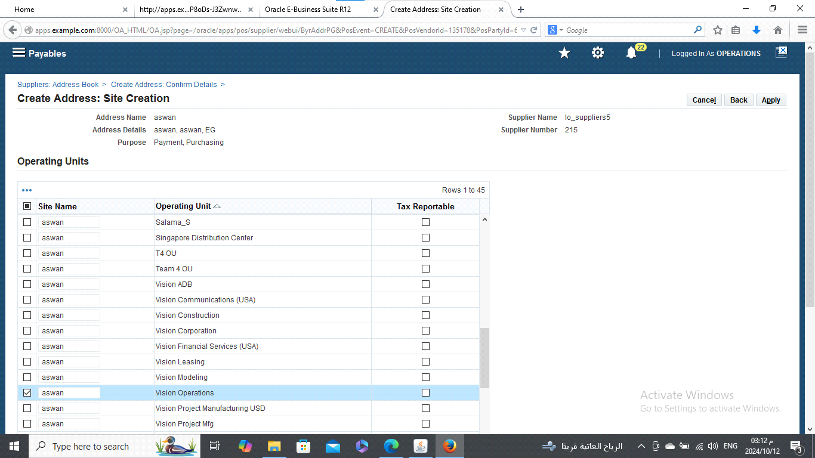
Select my site name then apply

Slide 11
Save and now we have created the supplier

Slide 12

Create invoices:
Navigator :
Invoices
Entry - invoices

Slide 13
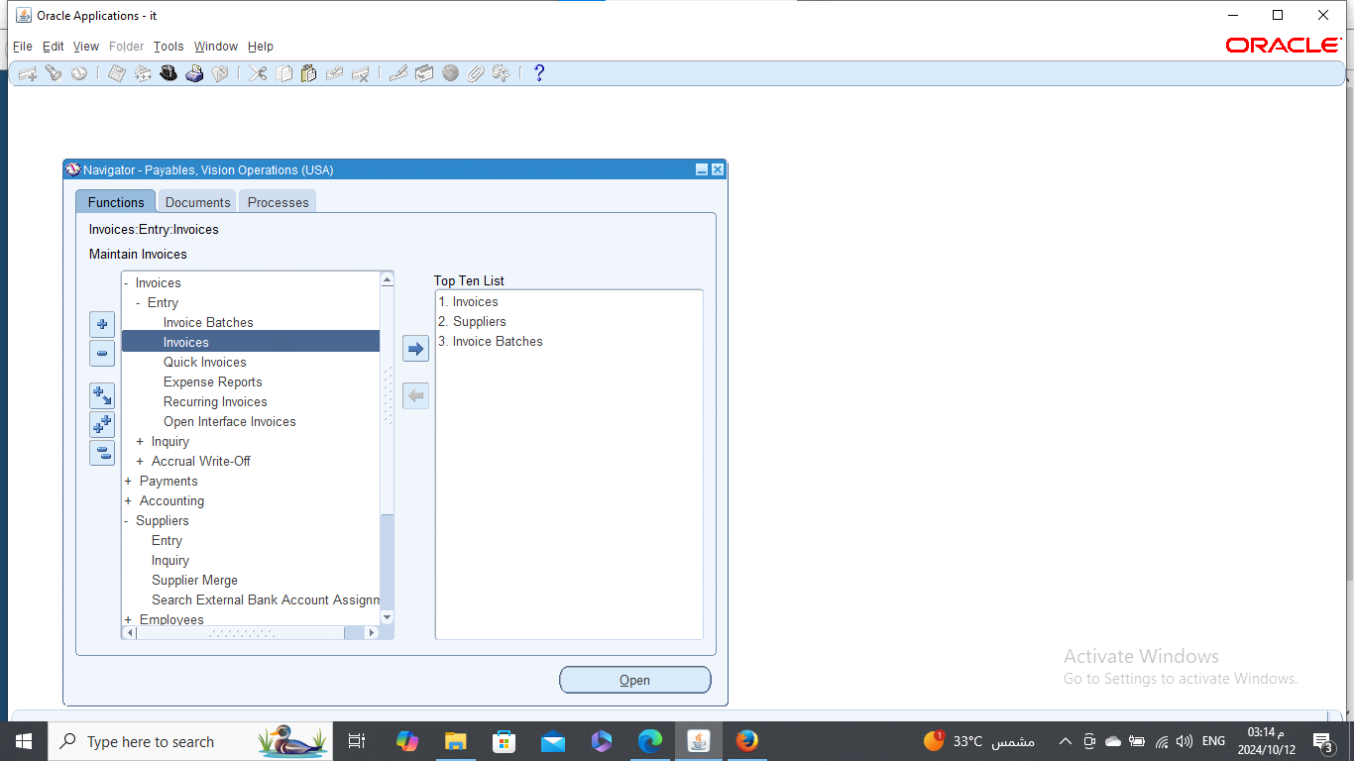

Slide 14
Use the ruler and move right
Enter the following:
- trading partner: lo_supplier5 - supplier num:215 -supplier site: Aswan
- invoice date: 1-12-2016 - invoice num:10 - invoice amount: 5000
- GL date: 1-12-2016 - terms date :1-12-2016 - terms: 45net
- payment method: check - pay group : AP group
* get down and press 2Lines
Enter the type:
- terms, fright and Miscellaneous
- enter the Distribution Account for the fright and miscellaneous
- press distribution to make sure that there isn't mistakes on the accounts

Slide 15
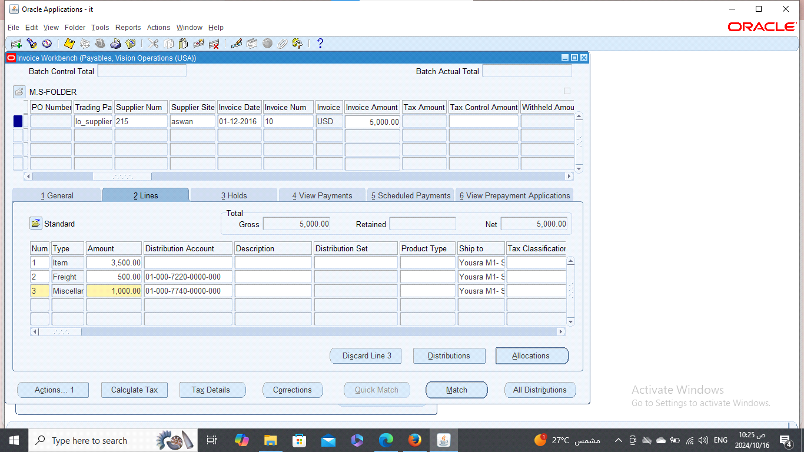

Slide 16
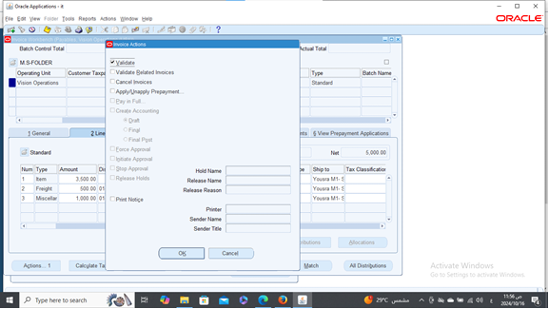
Press actions and select validate then ok

Slide 17
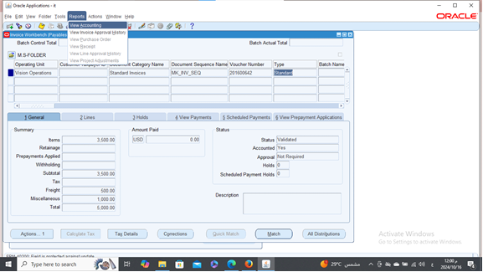
Now the invoice is validated and accounted
go to the menu bar and select reports - view accounting

Slide 18
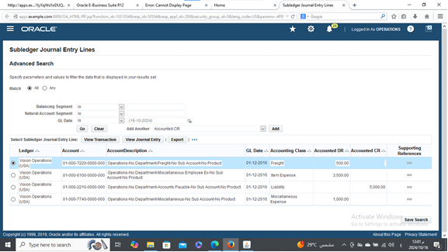
Result

Slide 19

Distribution set:
Navigator :
Setup
Invoices
Distribution sets

Slide 20
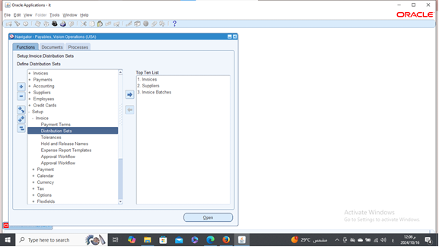

Slide 21
Enter the name and distribution

Slide 22
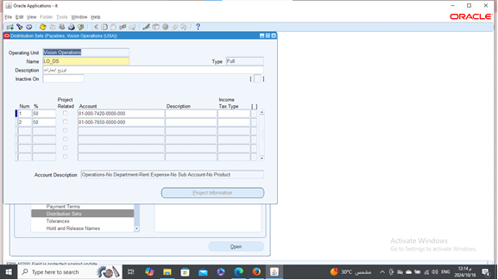

Slide 23
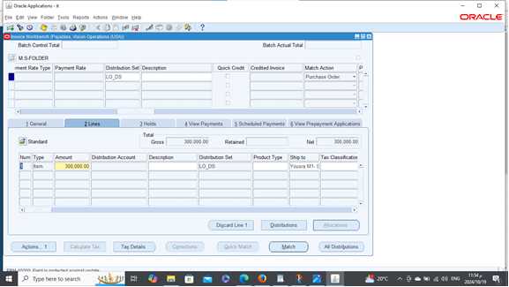
Create an invoice and enter the distribution name

Slide 24
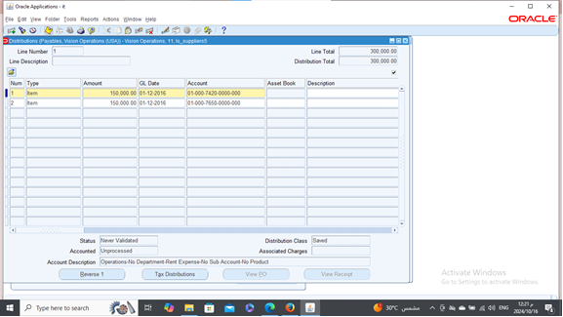
Press distribution and here the account well be as the percent we did

Slide 25
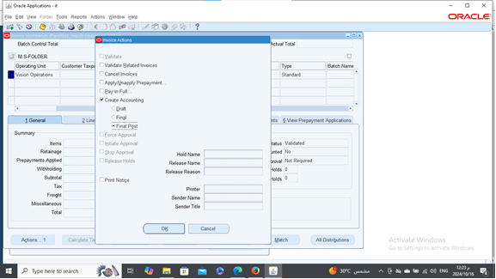
press actions...1 validate
one more time for create accounting - final post

Slide 26
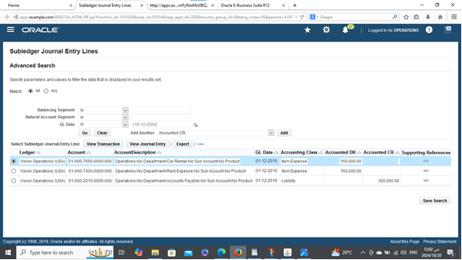
Result

Slide 27

Create a credit memo:
Standard invoice type
Choose type - credit memo
Invoice amount : negative number

Slide 28
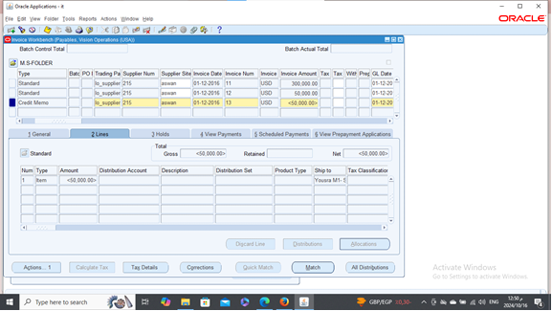

Slide 29
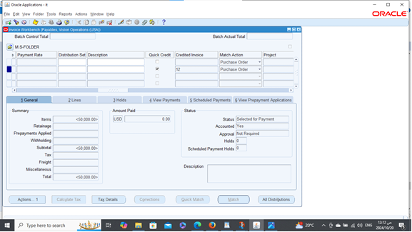
Select quick credit and enter the num of the invoice then Save

Slide 30
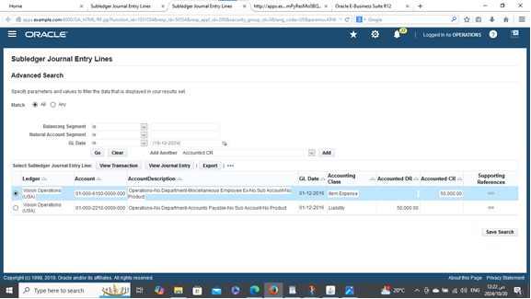
Reports - view accounting
Results

Slide 31

Tax for the invoice:
Navigator :
Setup
Options
Payables options

Slide 32
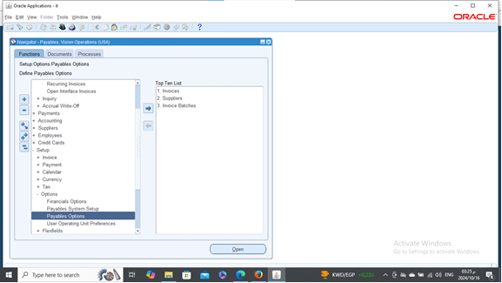

Slide 33
press withholding tax
01
make sure selecting: use withholding tax
02
at invoice validation time
03

Slide 34
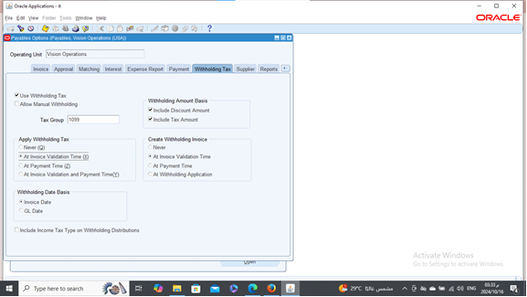
Invoice date

Slide 35
create a tax
Create a supplier as the first one
Navigator: supplier - entry

Slide 36
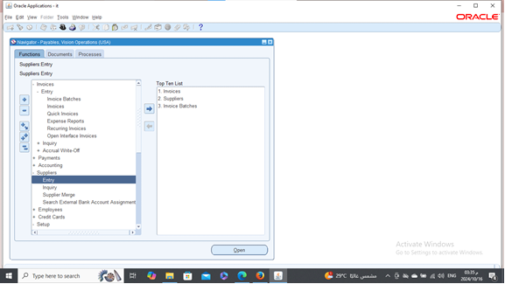

Slide 37
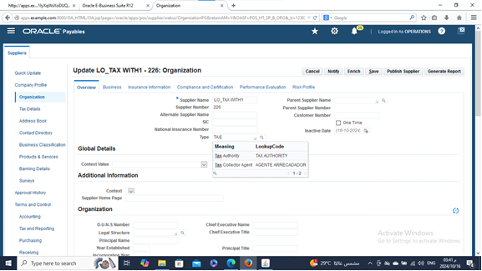
Press organization - choose the type - tax authority, then save

Slide 38
Create an address book
1
Select purchasing and payment
2
Press continue
3

Slide 39
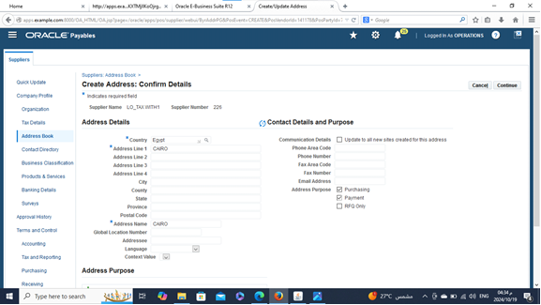

Slide 40
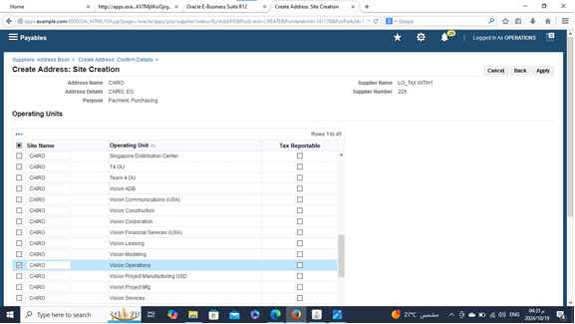
Choose your site name then apply

Slide 41
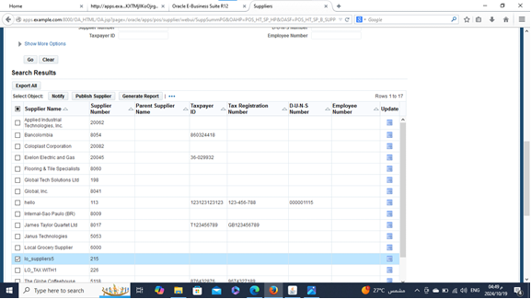
Back to the supplier site and search on your supplier
select your supplier's name and press update

Slide 42
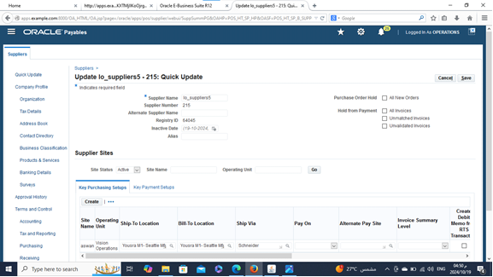

Slide 43
Select tax details
Press allow withholding tax
Scroll down and press allow withholding tax
Then save

Slide 44
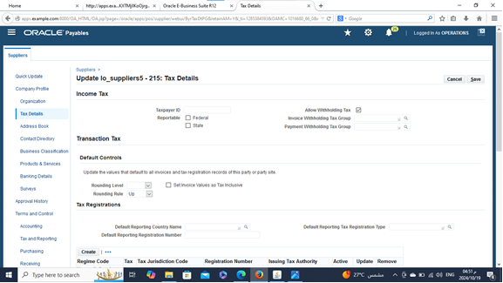

Slide 45
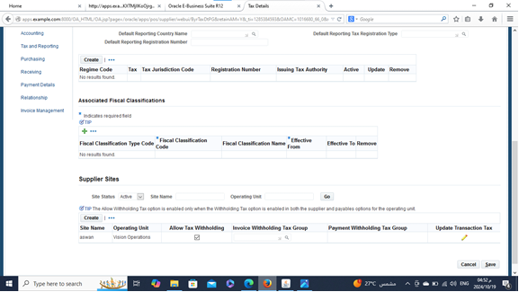

Slide 46


Create the tax:
Navigator:
Setup
Tax
codes

Slide 47
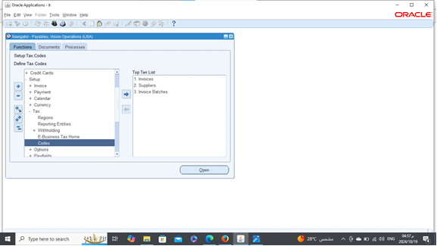

Slide 48
Add the tax authority
Make a tax code and the GL account
Choose the rate structure
Press on create withhold tax group
Add a rate
Then save and take the tax code copy

Slide 49
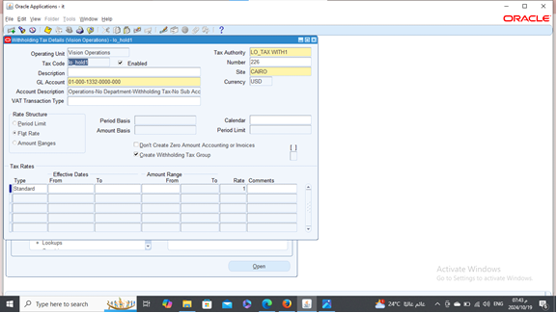

Slide 50
Open your supplier
Press on tax details
Paste your tax code on the invoice withholding tax group box
Scroll down and do the same thing then save

Slide 51
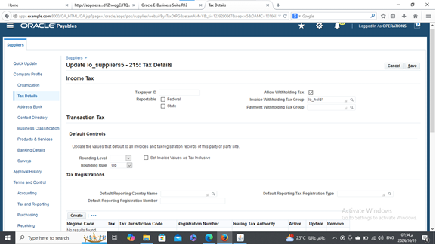

Slide 52
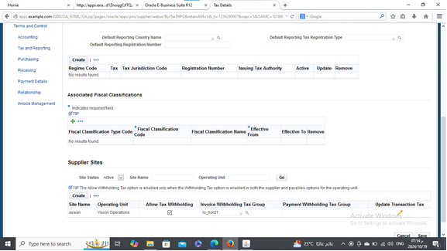

Slide 53

Create an invoice batch:
Navigator:
Invoices
Entry
Invoice batches

Slide 54
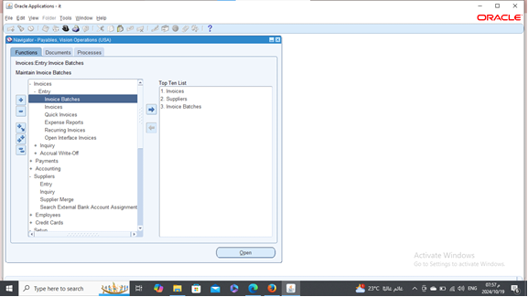

Slide 55
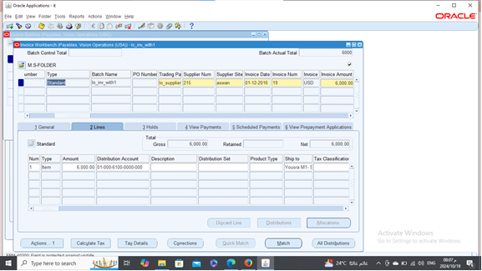
Press on invoices and create a standard invoice

Slide 56
Select actions...1
Validate
Then actions...1
Create accounting
Final post
Ok

Slide 57
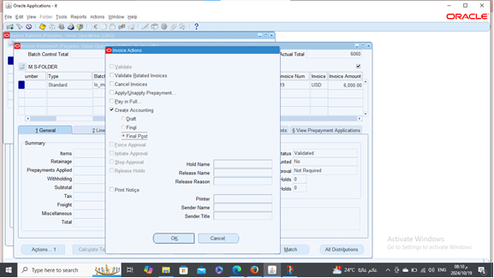

Slide 58
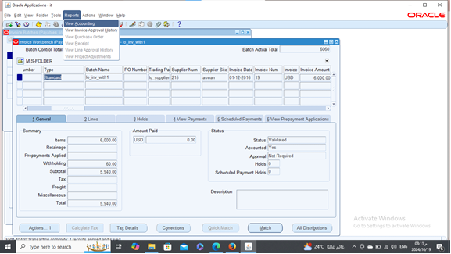
Reports: View accounting

Slide 59
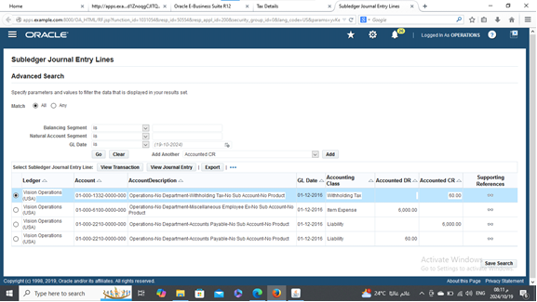
Result

Slide 60
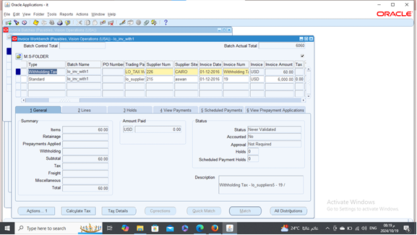
Invoice withholding tax press on ( ctrl+f11)

Slide 61

Create accounting
Final post
Ok

Slide 62
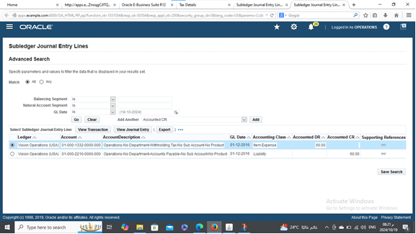
Result

Slide 63
Payment to the invoice:
Pay in full
Ok

Slide 64
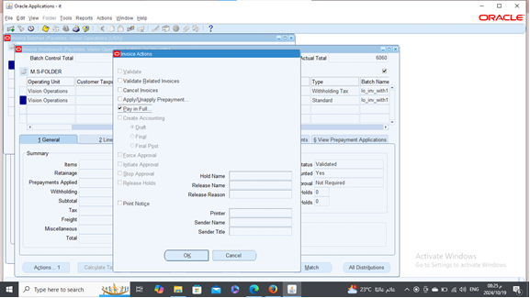

Slide 65
Add the following:
The payment date : 1-12-2016
The bank account: mkm%
Payment process profile: standard check format
Then save

Slide 66
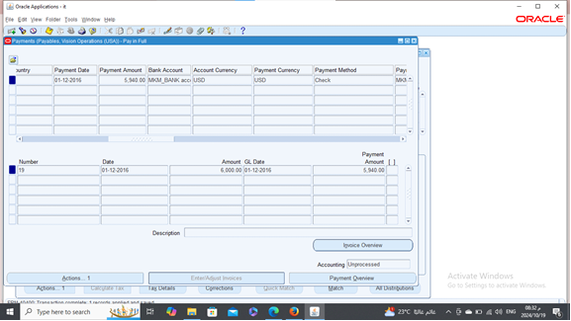

Slide 67
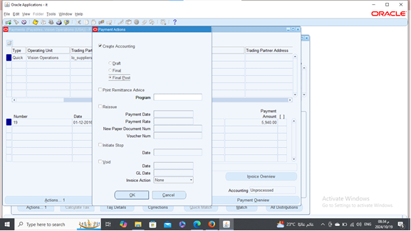
Create accounting final post (do the same thing for the withhold tax)

Slide 68

Result

Slide 69

Discount:
Navigator:
Setup
Invoice
Payment terms

Slide 70
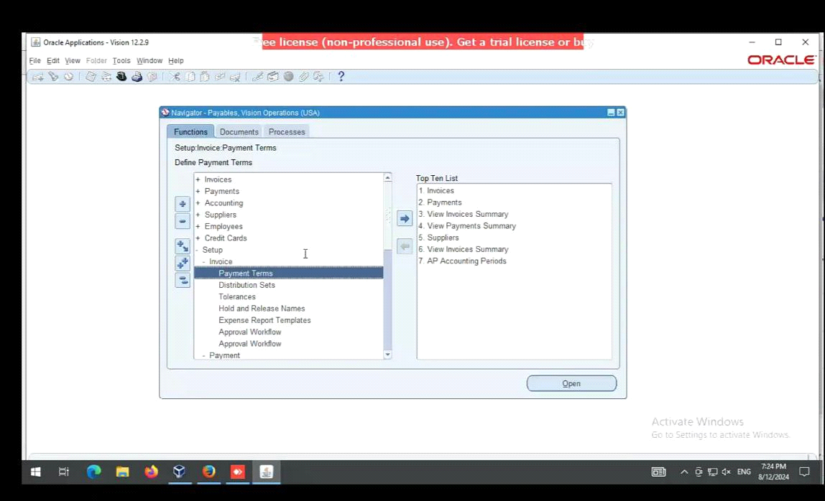

Slide 71
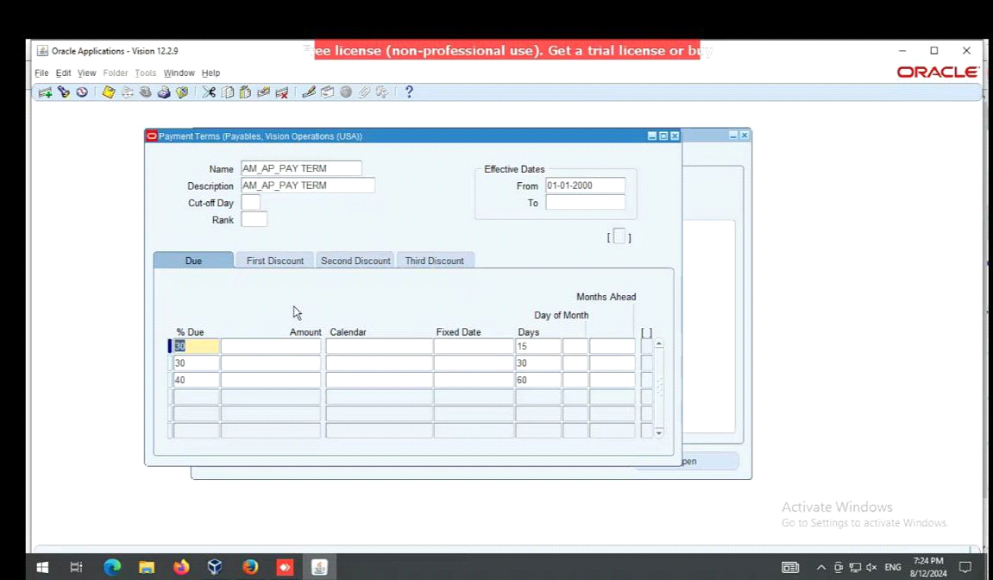
Enter the payment name, due and days

Slide 72
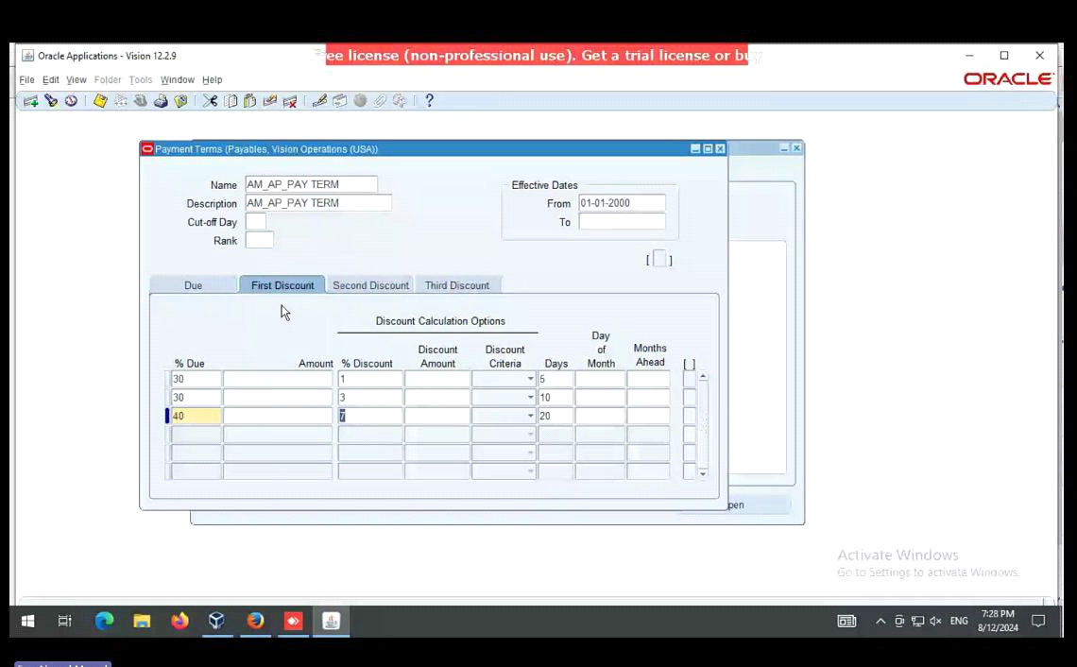
Select the first discount box
Add the discount and days

Slide 73
Create an invoice for the discount
Navigator:
Invoices
Entry
Invoices
Find my supplier and select an invoice which didn't paid
The type : prepayment
Terms: immediate
Select 2 lines box and add the amount

Slide 74
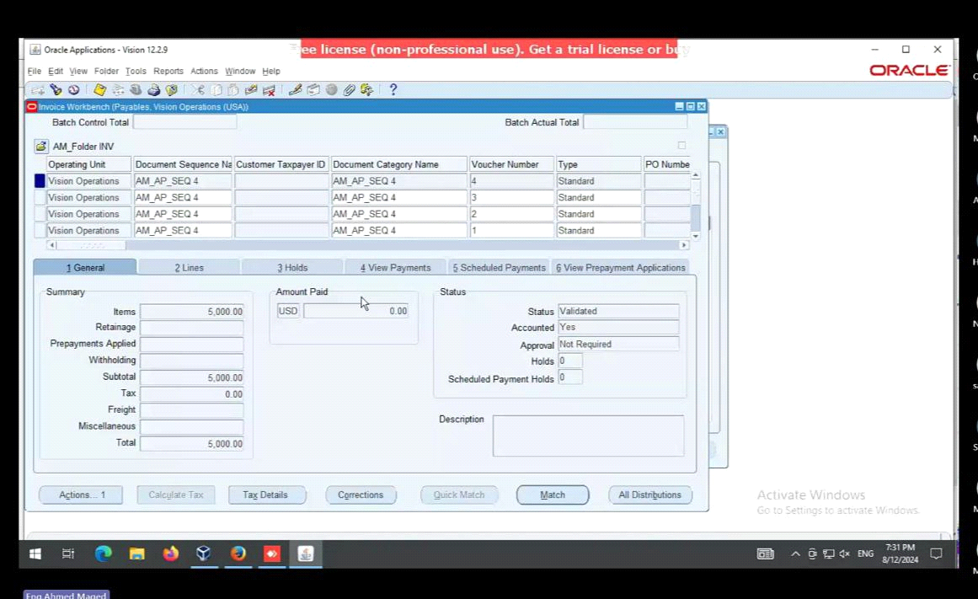

Slide 75
Actions:
Validate
Actions:
Create accounting
Final post
Actions:
Pay in full

Slide 76
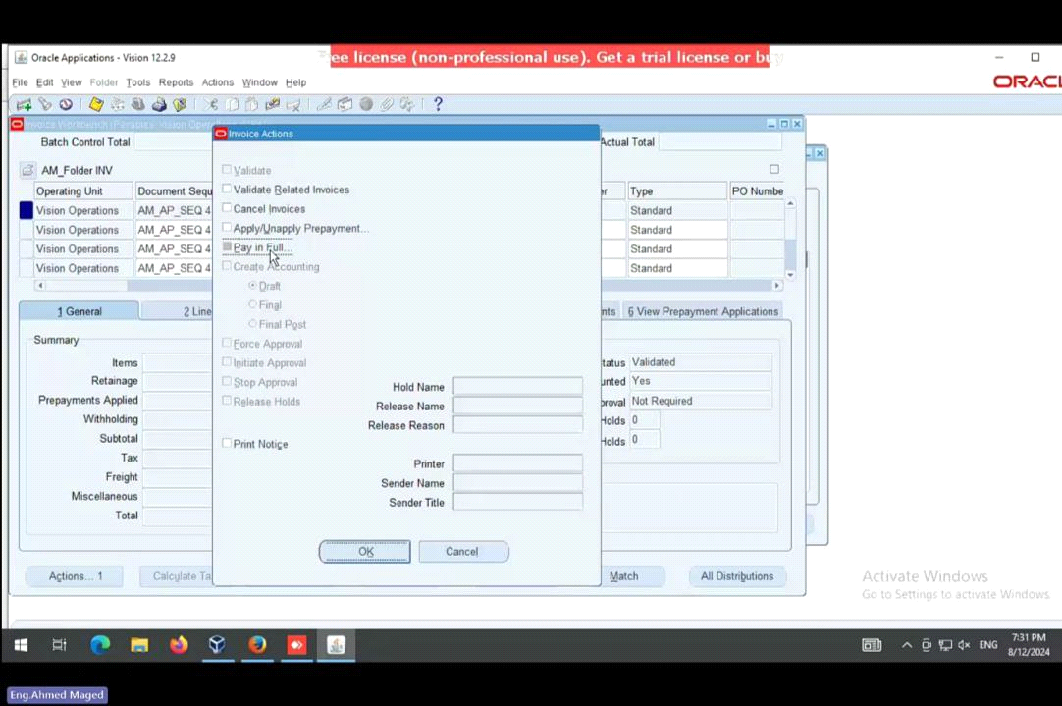

Slide 77

Add my payment document , payment process profile, payment method, bank account and the date then save

Slide 78

Actions - create accounting - final post

Slide 79

Result

Slide 80

Payment Processing and Cash Management

Slide 81
Process supplier payments:
* How to process payments for posted invoice:
After post, the invoice and the due date come to pay the invoice we have more than one way first from invoice tap itself click action then choose pay in full to open to you the payment form.

Slide 82


Slide 83

Entre the bank account and payment method and complete other needed information and the invoice will appear then click action create final post

Slide 84


Slide 85

We can see the transaction entries from tools , view accounting

Slide 86

The second way to make payment to the invoice is through payments form

Slide 87

It open the same window as the first one, but we will enter all the information needed first like trading partner, bank account , payment date and GL date and the payment method and then choose the invoice.

Slide 88


Slide 89
Process different types of payments:
* When we make an invoice, we can choose one from the different payment methods check, electronic payment or bill payables or other types

Slide 90


Slide 91

we can choose the payment method from the payments screen

Slide 92
Payment Batch:
* Create and process payment batches for multiple invoices
First, we created invoices in some day and post it

Slide 93


Slide 94

From payments we choose payment manager and then submit single payment process request and complete the needed information

Slide 95


Slide 96


Slide 97


Slide 98
Handel prepayments and advances:
* Learn how to process supplier prepayments and advances
When making a prepayment to supplier first we create an invoice from prepayment type.

Slide 99


Slide 100
Apply the prepayment to future invoice:
After make the payment and receive the items from the supplier we make another invoice with standard type and apply the payment with the prepayment

Slide 101


Slide 102


Slide 103


Slide 104

Select the amount and then click apply and then the invoice appears paid:

Slide 105
Void payments and refunds:
* Process payment for incorrectly issued invoice payments.
We will go to the payment screen and select the incorrect payment and void it
Assume that this is the incorrect payment click action then void

Slide 106


Slide 107

After void, the payment the amount is reversed

Slide 108


Slide 109
Record refund from suppliers and apply them to the appropriate:
We make the credit memo and debit memo when we return the purchases to the supplier because of incorrect or defective purchases
We Make the standard invoice first and then make the credit memo by minus amount and check the quick credit box to choose the standard invoice number we want to return

Slide 110


Slide 111


Slide 112
Cash Management:
* RECONCILIATION:
When we receive the bank statement from the bank we make reconcile to the payment
Reconciliation in the CM module can be through manual clearing or by bank statement reconciliation

Slide 113

Fist manual clearing

Slide 114

Choose the AP payment and write the bank account number then click find

Slide 115

Choose the payment and click clear transaction

Slide 116


Slide 117

After that we post the transaction manually or by submit create accounting request

Slide 118

The transaction become crediting the cash to the liability

Slide 119

Second the bank statement reconciliation

Slide 120

Enter the bank account and the number and the date then click available

Slide 121

The payments choose one then click reconcile

Slide 122
The payments choose one then click reconcile

Slide 123


Slide 124

When create the account we see that the payment reconciled

Slide 125

Period Ending, Closing and Reporting

Slide 126
AP period-end close:
* Perform the AP period-end closing process:
The AP period-end closing process is typically performed at the end of each accounting period (monthly, quarterly, semi-annually or annually). This process is completed after all transactions have been recorded and posted to GL.

Slide 127

Choose accounting → control payables periods

Slide 128

Enter the ledger name

Slide 129

Choose the period ended to close it

Slide 130


Slide 131
Ensure all invoices and payments are posted before closing the period:
Before we close the accounting period, we should ensure that all invoices and payment have been posted to GL.

Slide 132

If there are unposted invoice or payment the period would not close until handle these problem

Slide 133

We can see the exceptions review and solve the problem

Slide 134

Generate financial reports:
Run key AP reports such as the invoice register, payment register, and supplier balance report

Slide 135

We can make these report from view → requests

Slide 136

We write the needed request and then submit it (Invoice register)

Slide 137

We can see the invoice register show all the invoices related to a supplier in particular period or date

Slide 138

Payment register

Slide 139

The payment register also show the payment to a particular supplier in a period

Slide 140

Supplier paid invoices history:

Slide 141

Review the Reports for Accuracy and Completeness:

Slide 142
Review and validate all generated reports to ensure the accuracy of financial data, cross-checking for consistency with source transactions, and verifying completeness to ensure that all relevant transactions, including invoices and payments, are properly recorded. Any discrepancies or missing information should be identified and resolved before finalizing the report.

Slide 143
Thanks $

